Slide 1
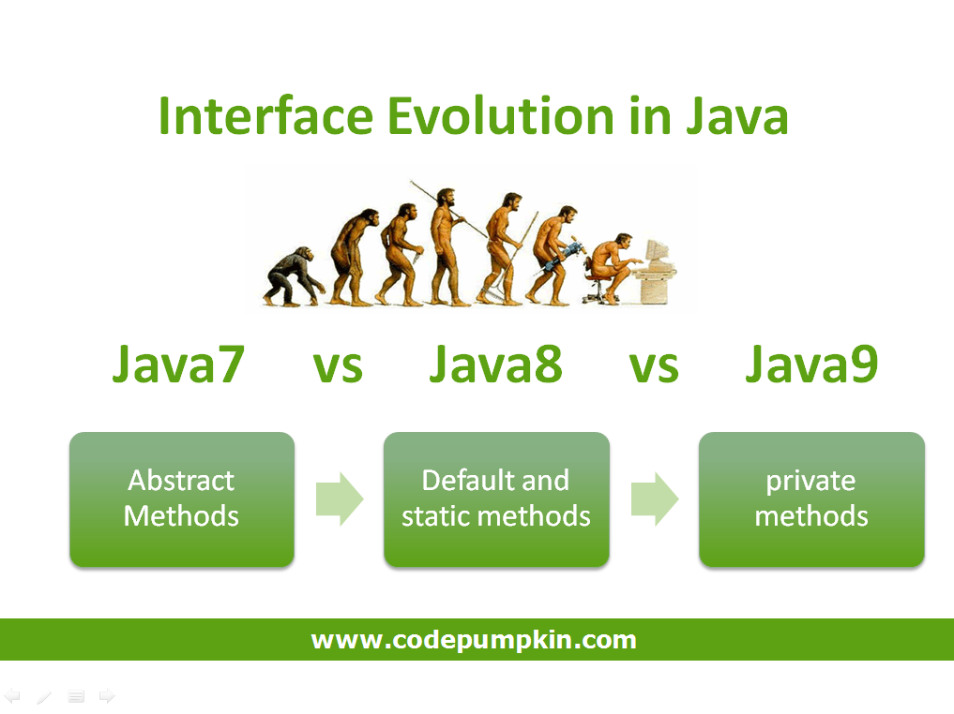
JAVA 9

Slide 2
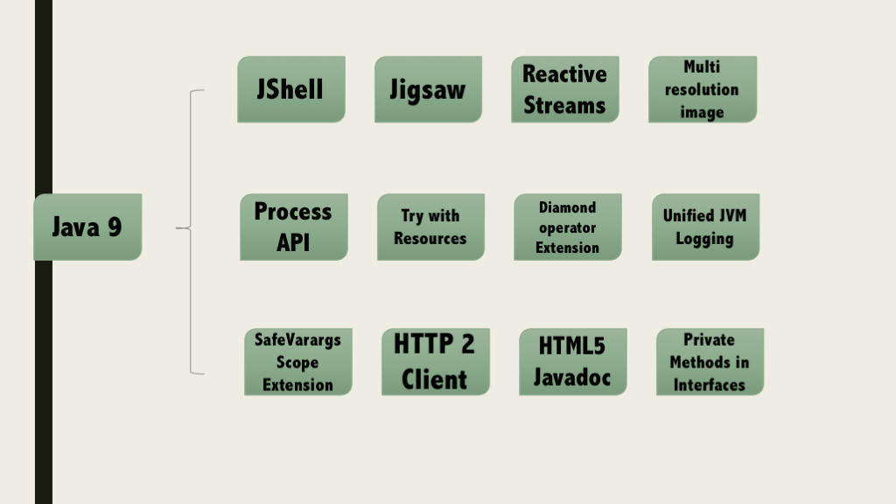
Presentation

Slide 3
Features of java 9
Java 9 REPL
Factory Methods for Immutable List, Set, Map and Map.Entry
Private methods in Interfaces
Java 9 Module System
Process API Improvements
Try With Resources Improvement
CompletableFuture API Improvements
Reactive Streams
Diamond Operator for Anonymous Inner Class
Optional Class Improvements
Stream API Improvements
Enhanced @Deprecated annotation
HTTP 2 Client
Multi-Resolution Image API

Slide 4
RPI In JAVA 9
G:\>jshell
| Welcome to JShell -- Version 9-ea
| For an introduction type: /help intro
jshell> int a = 10
a ==> 10
jshell> System.out.println("a value = " + a )
a value = 10
Notes:
Oracle Corp has introduced a new tool called “jshell”. It stands for Java Shell and also known as REPL (Read Evaluate Print Loop). It is used to execute and test any Java Constructs like class, interface, enum, object, statements etc. very easily.

Slide 5
Factory Methods for Immutable List, Set, Map and Map.Entry
Empty List Example
List immutableList = List.of();
Non-Empty List Example
List immutableList = List.of("one","two","three");
Map has two set of methods: of() methods and ofEntries() methods to create an Immutable Map object and an Immutable Map.Entry object respectively.
Empty Map Example
jshell> Map emptyImmutableMap = Map.of() emptyImmutableMap ==> {}
Non-Empty Map Example
jshell> Map nonemptyImmutableMap = Map.of(1, "one", 2, "two", 3, "three") nonemptyImmutableMap ==> {2=two, 3=three, 1=one} If you want to read more about these utility methods, please go through the following links:
Notes:
Oracle Corp has introduced some convenient factory methods to create Immutable List, Set, Map and Map.Entry objects. These utility methods are used to create empty or non-empty Collection objects.
In Java SE 8 and earlier versions, We can use Collections class utility methods like unmodifiableXXXto create Immutable Collection objects. For instance, if we want to create an Immutable List, then we can use Collections.unmodifiableList met,hod.
However these Collections.unmodifiableXXX methods are very tedious and verbose approach. To overcome those shortcomings, Oracle corp has added couple of utility methods to List, Set and Map interfaces.
List and Set interfaces have “of()” methods to create an empty or no-empty Immutable List or Set objects as shown below:

Slide 6
Private methods in Interfaces
public interface Card{
private Long createCardID(){
// Method implementation goes here.
}
private static void displayCardDetails(){
// Method implementation goes here.
}
}
Notes:
In Java 8, we can provide method implementation in Interfaces using Default and Static methods. However we cannot create private methods in Interfaces.
To avoid redundant code and more re-usability, Oracle Corp is going to introduce private methods in Java SE 9 Interfaces. From Java SE 9 on-wards, we can write private and private static methods too in an interface using ‘private’ keyword.
These private methods are like other class private methods only, there is no difference between them

Slide 7
Java 9 Module System
One of the big changes or java 9 feature is the Module System. Oracle Corp is going to introduce the following features as part of Jigsaw Project.
Modular JDK
Modular Java Source Code
Modular Run-time Images
Encapsulate Java Internal APIs
Java Platform Module System
Before Java SE 9 versions, we are using Monolithic Jars to develop Java-Based applications. This architecture has lot of limitations and drawbacks. To avoid all these shortcomings, Java SE 9 is coming with Module System.
JDK 9 is coming with 92 modules (may change in final release). We can use JDK Modules and also we can create our own modules as shown below:

Slide 8
Process API Improvements
ProcessHandle currentProcess = ProcessHandle.current();
System.out.println("Current Process Id: = " + currentProcess.getPid());
Notes:
Process API Improvements
Java SE 9 is coming with some improvements in Process API. They have added couple new classes and methods to ease the controlling and managing of OS processes.
Two new interfcase in Process API:
java.lang.ProcessHandle
java.lang.ProcessHandle.Info

Slide 9
Try With Resources Improvement
Java SE 7 example
void testARM_Before_Java9() throws IOException{ BufferedReader reader1 = new BufferedReader(new FileReader("journaldev.txt"));
try (BufferedReader reader2 = reader1) { System.out.println(reader2.readLine()); } }
Java 9 example
void testARM_Java9() throws IOException{ BufferedReader reader1 = new BufferedReader(new FileReader("journaldev.txt"));
try (reader1) { System.out.println(reader1.readLine()); } }
Notes:
We know, Java SE 7 has introduced a new exception handling construct: Try-With-Resources to manage resources automatically. The main goal of this new statement is “Automatic Better Resource Management”.
Java SE 9 is going to provide some improvements to this statement to avoid some more verbosity and improve some Readability.

Slide 10
CompletableFuture API Improvements
Executorexe=CompletableFuture.delayedExecutor(50L, TimeUnit.SECONDS);
Here delayedExecutor() is static utility method used to return a new Executor that submits a task to the default executor after the given delay.
Notes:
In Java SE 9, Oracle Corp is going to improve CompletableFuture API to solve some problems raised in Java SE 8. They are going add to support some delays and timeouts, some utility methods and better sub-classing.

Slide 11
Reactive Streams
Now-a-days, Reactive Programming has become very popular in developing applications to get some beautiful benefits. Scala, Play, Akka etc. Frameworks has already integrated Reactive Streams and getting many benefits. Oracle Corps is also introducing new Reactive Streams API in Java SE 9.
Java SE 9 Reactive Streams API is a Publish/Subscribe Framework to implement Asynchronous, Scalable and Parallel applications very easily using Java language.
Java SE 9 has introduced the following API to develop Reactive Streams in Java-based applications.
java.util.concurrent.Flow
java.util.concurrent.Flow.Publisher
java.util.concurrent.Flow.Subscriber
java.util.concurrent.Flow.Processo

Slide 12
Diamond Operator for Anonymous Inner Class
public List getEmployee(String empid){ // Code to get Employee details from Data Store return new List(emp){ }; }
Here we are using just “List” without specifying the type parameter. To read more details about this improvement, please go through my original tutorial at
Notes:
We know, Java SE 7 has introduced one new feature: Diamond Operator to avoid redundant code and verbosity, to improve readability. However in Java SE 8, Oracle Corp (Java Library Developer) has found that some limitation in the use of Diamond operator with Anonymous Inner Class. They have fixed that issues and going to release as part of Java 9.

Slide 13
Optional Class Improvements
Stream<Optional> emp = getEmployee(id) Stream empStream = emp.flatMap(Optional::stream)
Here Optional.stream() method is used convert a Stream of Optional of Employee object into a Stream of Employee so that we can work on this result lazily in the result code.
Notes:
In Java SE 9, Oracle Corp has added some useful new methods to java.util.Optional class. Here I’m going to discuss about one of those methods with some simple example: stream method
If a value present in the given Optional object, this stream() method returns a sequential Stream with that value. Otherwise, it returns an Empty Stream.

Slide 14
Stream API Improvements
jshell> Stream.of(1,2,3,4,5,6,7,8,9,10).takeWhile(i -> i < 5 )
.forEach(System.out::println);
1
2
3
4
Notes:
In Java SE 9, Oracle Corp has added four useful new methods to java.util.Stream interface. As Stream is an interface, all those new implemented methods are default methods. Two of them are very important: dropWhile and takeWhile methods
If you are familiar with Scala Language or any Functions programming language, you will definitely know about these methods. These are very useful methods in writing some functional style code. Let us discuss about takeWhile utility method here.
This takeWhile() takes a predicate as an argument and returns a Stream of subset of the given Stream values until that Predicate returns false for the first time. If first value does NOT satisfy that Predicate, it just returns an empty Stream.

Slide 15
Enhanced @Deprecated annotation
In Java SE 8 and earlier versions, @Deprecated annotation is just a Marker interface without any methods. It is used to mark a Java API that is a class, field, method, interface, constructor, enum etc.
In Java SE 9, Oracle Corp has enhanced @Deprecated annotation to provide more information about deprecated API and also provide a Tool to analyse an application’s static usage of deprecated APIs. They have add two methods to this Deprecated interface: forRemoval and since to serve this information.

Slide 16
HTTP 2 Client
jshell> import java.net.http.*
jshell> import static java.net.http.HttpRequest.*
jshell> import static java.net.http.HttpResponse.*
jshell> URI uri = new URI("http://rams4java.blogspot.co.uk/2016/05/java-news.html")
uri ==> http://rams4java.blogspot.co.uk/2016/05/java-news.html
jshell> HttpResponse response = HttpRequest.create(uri).body(noBody()).GET().response()
response ==> java.net.http.HttpResponseImpl@79efed2d
jshell> System.out.println("Response was " + response.body(asString()))
Notes:
In Java SE 9, Oracle Corp is going to release New HTTP 2 Client API to support HTTP/2 protocol and WebSocket features. As existing or Legacy HTTP Client API has numerous issues (like supports HTTP/1.1 protocol and does not support HTTP/2 protocol and WebSocket, works only in Blocking mode and lot of performance issues.), they are replacing this HttpURLConnection API with new HTTP client.
They are going to introduce new HTTP 2 Client API under “java.net.http” package. It supports both HTTP/1.1 and HTTP/2 protocols. It supports both Synchronous (Blocking Mode) and Asynchronous Modes. It supports Asynchronous Mode using WebSocket API.
We can see this new API at: http://download.java.net/java/jdk9/docs/api/java/net/http/package-summary.html

Slide 17
Multi-Resolution Image API
In Java SE 9, Oracle Corp is going to introduce a new Multi-Resolution Image API. Important interface in this API is MultiResolutionImage . It is available in java.awt.image package.
MultiResolutionImage encapsulates a set of images with different Height and Widths (that is different resolutions) and allows us to query them with our requirements.

Slide 18
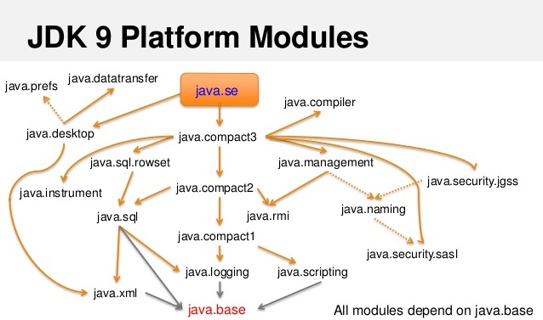
PROJECT MODELS(Jigsaw)

Slide 19
Prefer for website
https://www.journaldev.com/13121/java-9-features-with-examples
https://dzone.com/articles/java-9-besides-modules
https://dzone.com/articles/java-se-9-whats-new
https://aboullaite.me/wrapping-up-java-9-new-features/
https://codepumpkin.com/private-methods-interface-java-9/
https://blog.codefx.org/java/java-9-tutorial/

